Slide 1
Chapter 3
Methodology

Slide 2


Slide 3



Slide 4

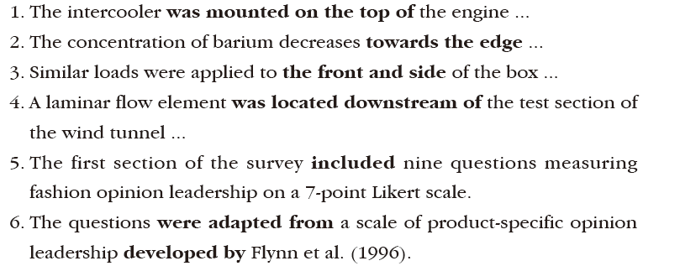

Slide 5
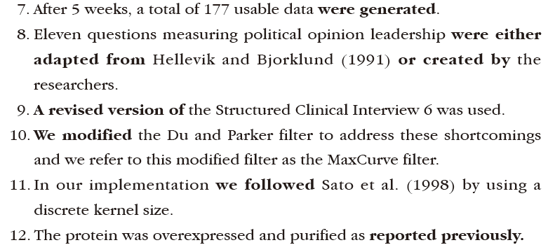

Slide 6

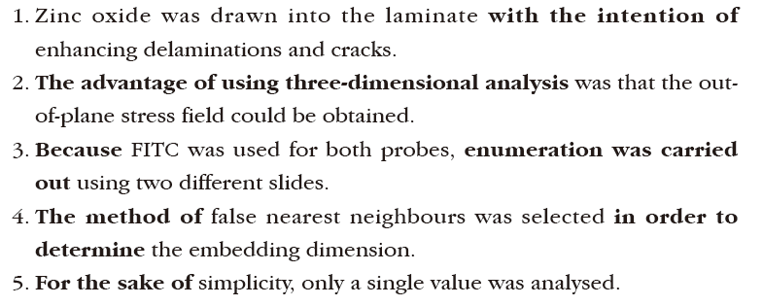

Slide 7


Slide 8

